Slide 1
Spark SQL Alpha
张包峰

Slide 2
Catalog
Spark SQL Overview
Catalyst
vs. Shark

Slide 3
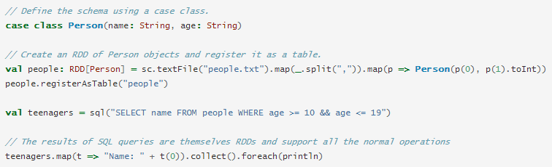
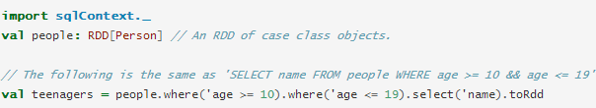
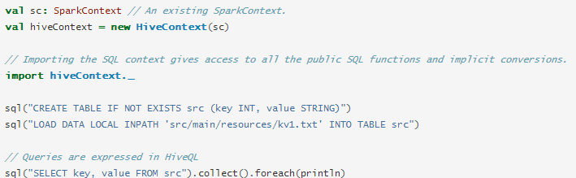
What`s in Spark SQL
SchemaRDD
支持sql或DSL
RDD来源
  普通RDD
  从Hive获取
  Parquet File与RDD

Slide 4
Spark SQL Modules
Spark SQL
  sql
  DSL
  Parquet Support
Catalyst
  Framework-free Query Optimization
Hive

Slide 5
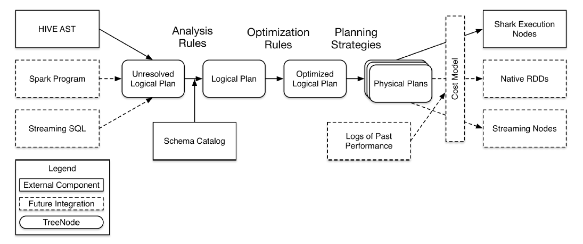
Catalyst Achitecture

Slide 6
Catalyst Overview
Rule & RuleExecutor
  Analysis
  Optimization
TreeNode
Expression
QueryPlan
  Logical Plan
  Spark Plan
Planning & Strategy

Slide 7
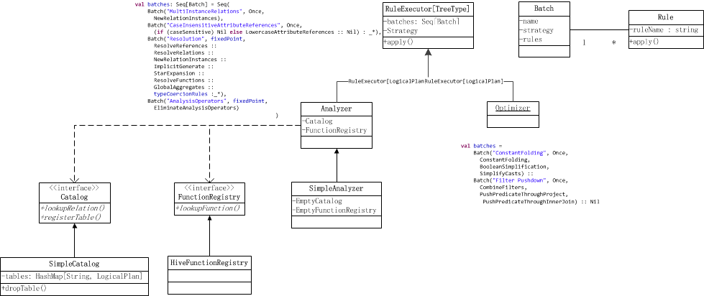
Rule Classes

Slide 8
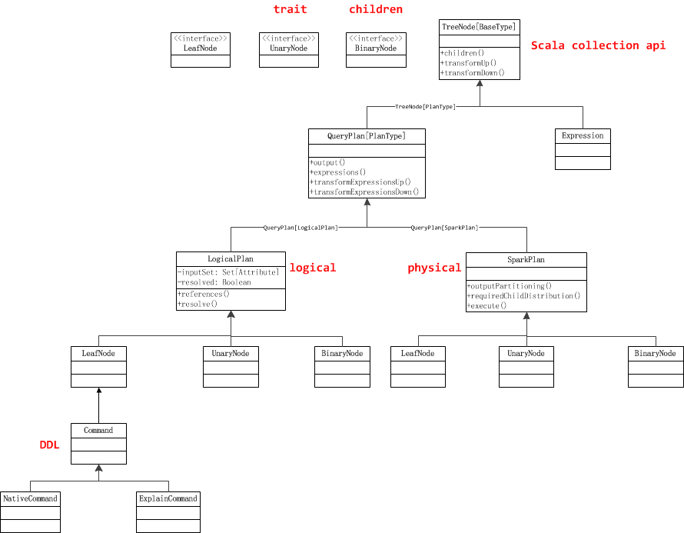
QueryPlan Classes

Slide 9
Expression Classes

Slide 10
Parse
把初始的sql进行简单的词法语法解析，结果会包含Expression，LogicalPlan等

Slide 11
Analysis
从logical plan的某个case class变到同一个logical plan的这个case class，一般改变变量

Slide 12
Optimization
往往是遍历每个logical plan，凡是里面有满足偏函数的节点，就利用Expression去替换，改写

Slide 13
Planning Strategy
把logicalPlan同physicalPlan对应起来

Slide 14
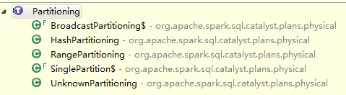
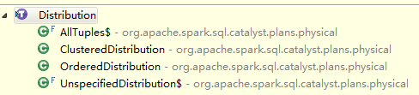
Distribution & Partitioning
Distribution
  Inter-node partitioning of data
  Intre-partition ordering of data
Aggregate操作

Slide 15
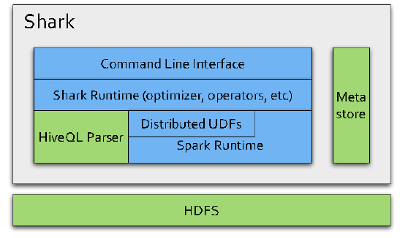
Shark overview
Based on Hive CodeBase but hard to optimize and maintain
Achieve performance by swapping out the physical execution engine

Slide 16
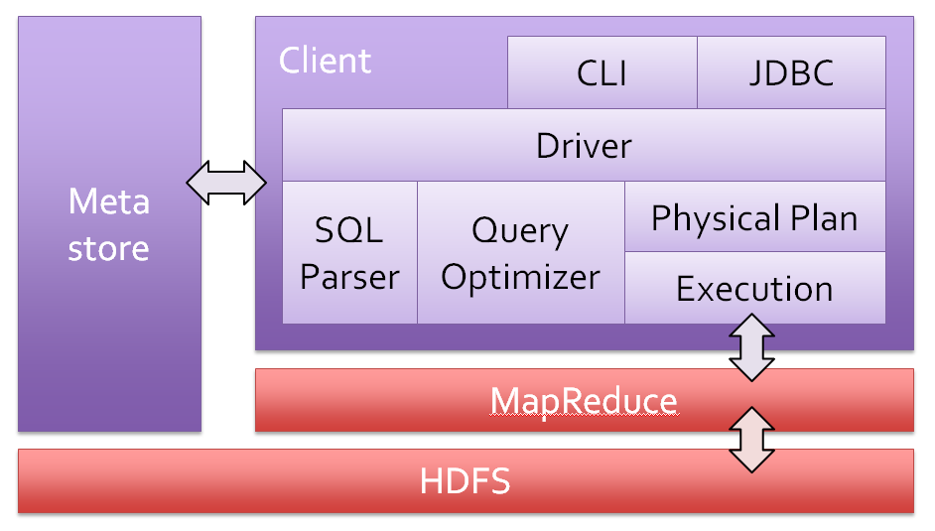
Hive Achitecture

Slide 17
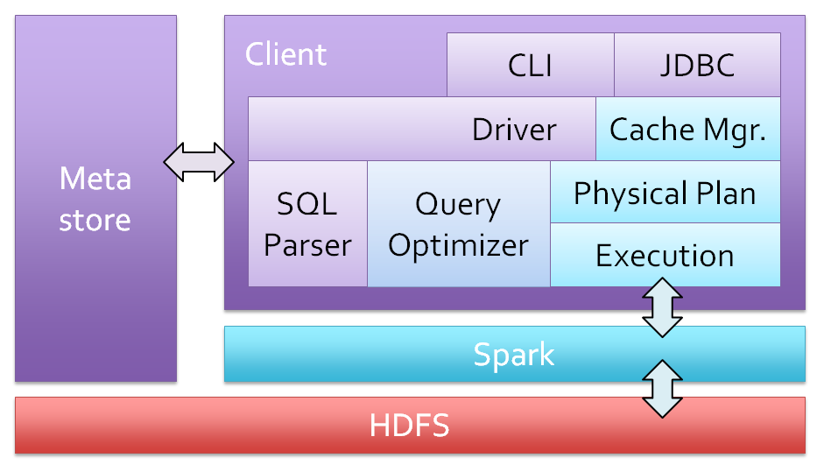
Shark Architecture

Slide 18
Shark & Hive
Use hive as Third-Party jar
  Query parsing
  Logical plan generation
Cache Manage
Physical execution on Spark
  Cache RDD Distributed in Memory
  Recomputable for Failure

Slide 19
Diff
 | Spark SQL | Shark

Slide 20
Shark in Future
Still Drop-In & Hive compatibility
Spark SQL for query opimization
Standalone SharkServer
JDBC/ODBC

